Slide 1
Glove for the deaf
Name | e-mail
Mahmoud Ashraf Mahmoud | Soliman20015@gmail.com
Mohamed Hatem | Es-MohamedHatem2024@alexu.edu.eg
Abdallah osama | abdallaosama341@gmail.com

Slide 2
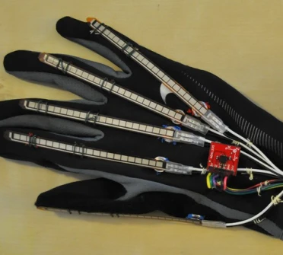
Glove For The Deaf

Slide 3
Introduction
Main objective of our project is to turn sign language to text that appear on an lcd using flex sensors.
Text will appear on LCD depending on fingers closed.
Uart is used to make the use of glove by minimum number of wires as possible.
A glove is worn by the user in which 1 flex sensor is placed on each finger in hand.
ADC is used to Convert analog signal from flex sensor to digital signal to be read by atmel atmega 32

Slide 4
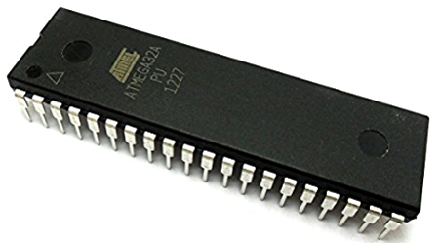
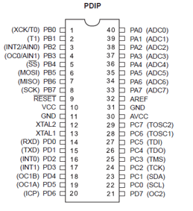
Components
ATmel ATMEGA32:
The Atmel ATmega32A is a low-power CMOS 8-bit microcontroller based
on the AVR enhanced RISC architecture with low cost.
It is a high-performance, Low-power Atmel AVR 8-bit Microcontroller.
It has High Endurance Non-volatile Memory segments.
Pinouts ATmega32

Slide 5
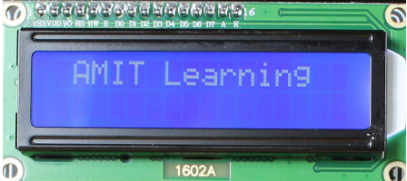
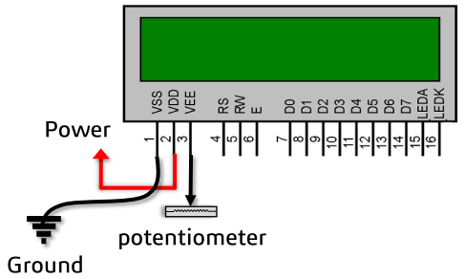
Components
LCD 1602A:
It can display 2 lines each having 16 characters.
It has 16 pins.

Slide 6
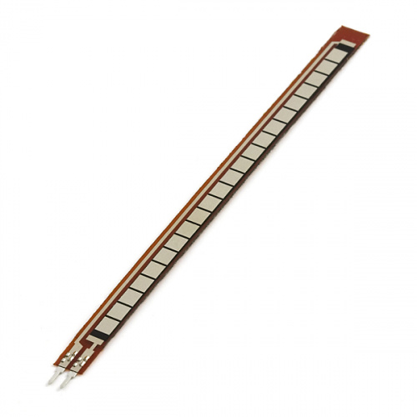
Components
Flex sensors:
A flex sensor or bend sensor is a sensor that measures the amount of deflection or bending.
It sends analog signal.
A flex sensor uses carbon on a strip of plastic to act like a variable resistor.
X5 flex sensors are used,one sensor is placed on each finger.

Slide 7
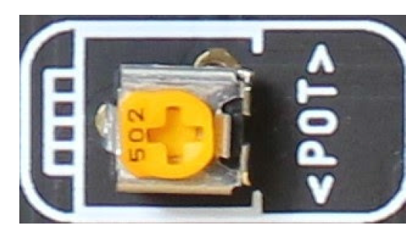
Components
ADC(Analog-to-digital converter):
It is used to convert analog signal taken from flex sensor to convert it to digital signal to be read by microcontroller.

Slide 8
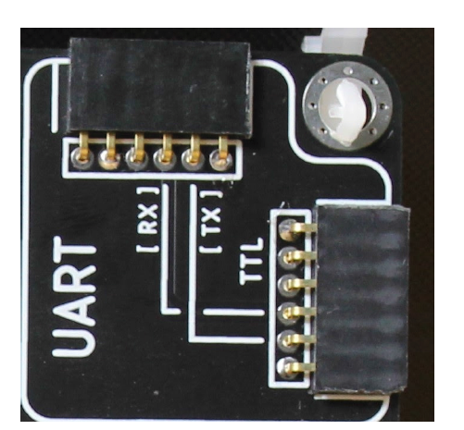
Components
Uart:
We use it to communicate with flex sensors using Bluetooth module to use less wires in connections.

Slide 9
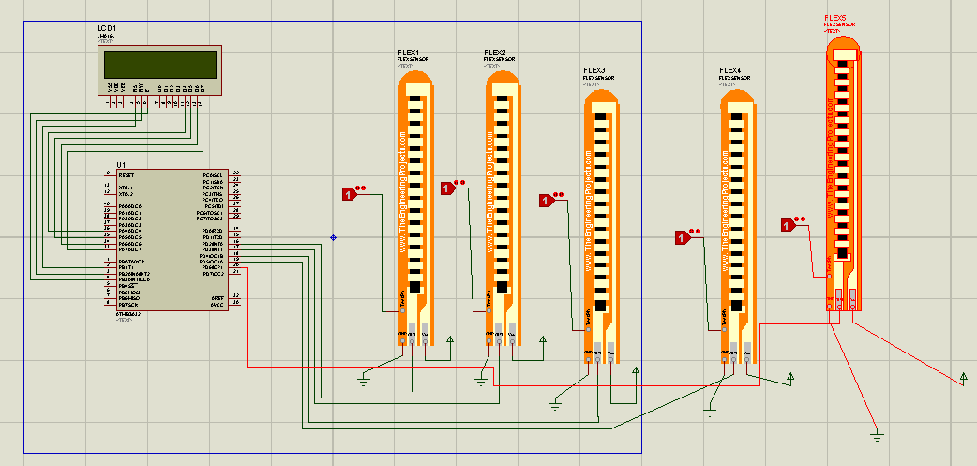
Proteus simulation
0 means finger is opened
1 means finger is closed

